Slide 1
Adroitly
Presentation by Jaxmine

Slide 2
FMP:
End of the year -
Specific & creative -
Challenging -
Fun but stressful -

Slide 3
Initial Ideas:
Print magazine -
Promoting Black women -
Monochrome, green & purple -
Local -

Slide 4
Adroitly:
A luxury magazine focused on promoting & celebrating Black women
Helping young Black women start their career path
Aspiring business owners
16 pages (including front & back)
Print magazine

Slide 5
Chosen Because:
Enjoyment -
Professional career -
Improvement -
Challenge -

Slide 6
Target Audience:
Primary:
18-25 year olds, Black women
Social Grade A
A02, Rich neighbourhood in city
Reformers
Secondary: 26-30 year olds, Black, Social Grade B, City
Tertiary: 31-40 year olds, Women, Social Grade C1, Aspirers, B05

Slide 7
Challenges:
Magazine design -
Writing formally & professionally -
A luxury magazine means a high-end product -

Slide 8
Primary Research:
Interview & Copywriters Feedback

Slide 9
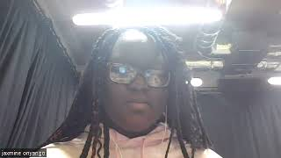
VERU Interview:
Research interview -
Learnt about VERU -
Help with writing article -

Slide 10
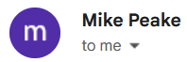
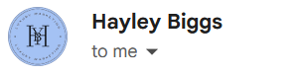
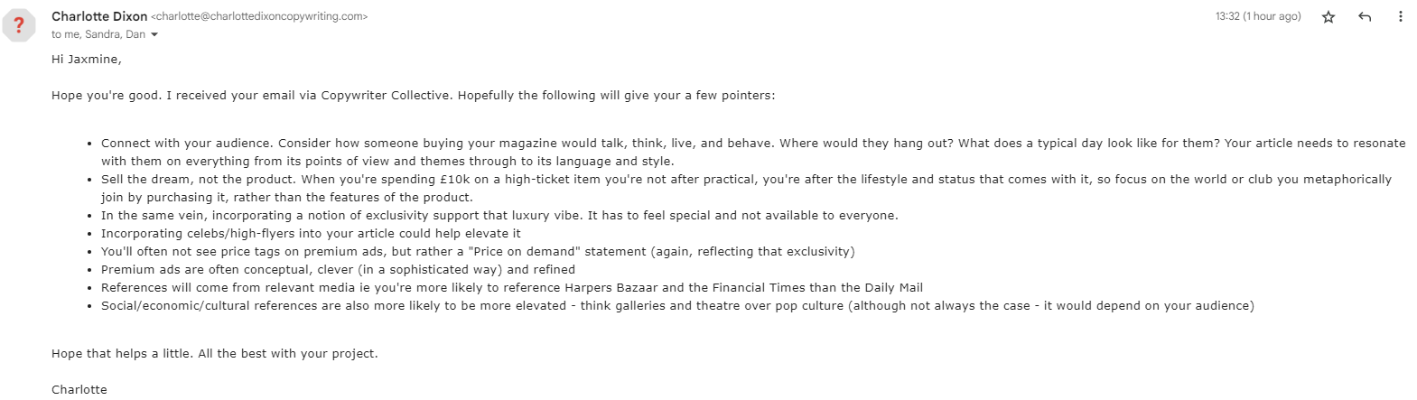
Copywriters:
Feedback -
The luxury market doesn't need an 'explainer' -
Framework for writing (6 questions) -
Flattery works well -
Write what the audience desires -
No visible prices on adverts -

Slide 11
Secondary Research:
Articles, Brand, Magazine

Slide 12
Articles:
Articles: topics, tone, style -
Formal & descriptive -
Biggest topics are fashion, beauty, lifestyle and travel -
Promoting, flattery -

Slide 13
Article Ideas:
Six articles in total -
The Oscars -
Work/life balance -
Fashion -
Top 10 list of beauty products -
CV/interview advice -
Promoting a Black owned business -
Holiday recommendations -
Historical Black figure -
Mental health -

Slide 14
Secondary Research:
Brand: logos, colour scheme, social media -
Serif or handwritten font -
Name or nouns, one or two words -
Black, white & accent colour -
Twitter, Instagram & Facebook -

Slide 15
Secondary Research:
Magazine: layout, fonts, adverts -
Fonts consistent throughout -
Adverts about fashion & beauty -
Layout fundamentals -

Slide 16
Links Between:
Copywriters feedback & Articles research
- Sophisticated, formal, descriptive over factual advertisements
- Include celebrities & high-flyers

Slide 17
Production Stages:
Pre-production, Production, Post-production

Slide 18
Pre-Production:
Articles: Research, draft & write -
Documents: Design brief, font justification -
Mock ups: Magazine -
Focus Group & Magazine Designer: Sourcing -
Interview: Scheduling, attending event -

Slide 19
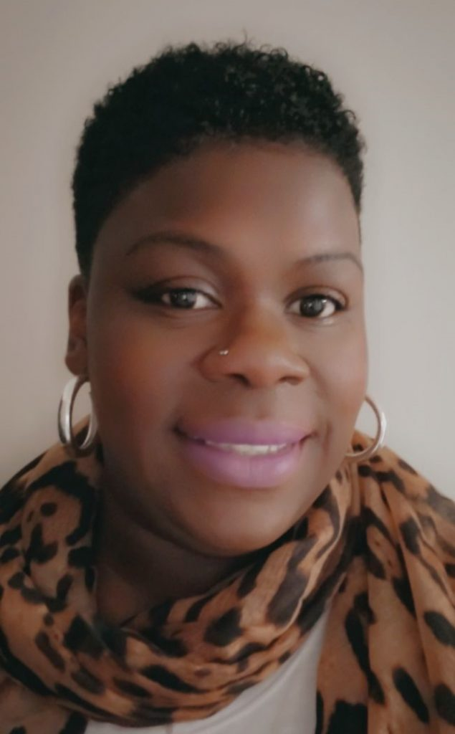
Pre-Production:
Interview: Scheduling -
Tasha Case, Community & Engagement Lead -
Works for BVERU -
Already contacted -

Slide 20
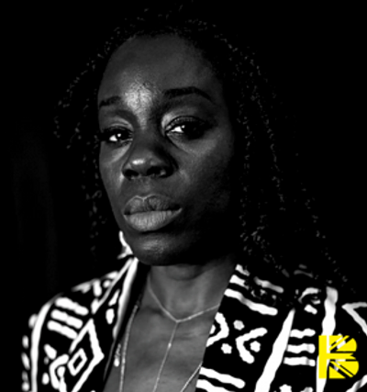
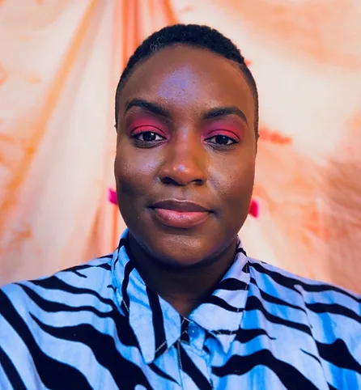
Pre-Production:
Interview: Attending event -
Akua Gyamfi, founder of the British Black List -
Gabrielle A Smith, founder of The NUBLK -
Bute Street Film Festival -

Slide 21
Production:
Designing magazine -
Taking photos in the studio -
Feedback from focus group & magazine designer -

Slide 22
Post-Production:
Industry & audience feedback -
Send to printers by Week 11 (16th May) -
Evaluation -

Slide 23
Contingency:
Focus group: Sourcing offline -
Interviews: emails, articles -
Working ahead of schedule -
Focusing on sourcing people early -

Slide 24
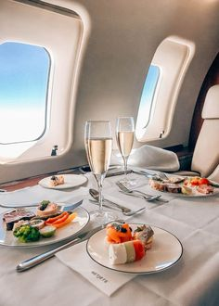
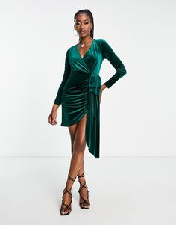
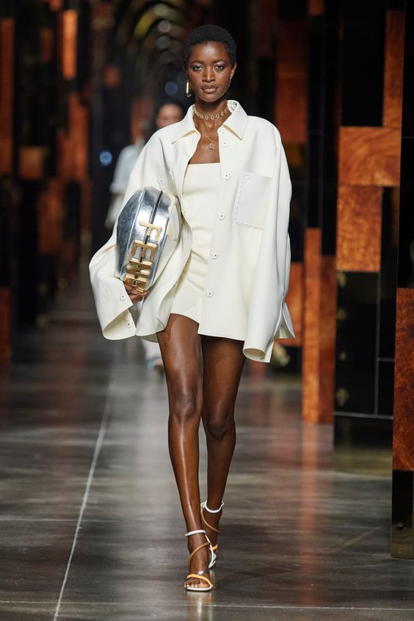
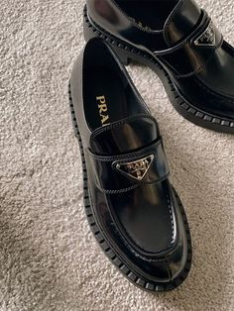

Moodboard:

Slide 25
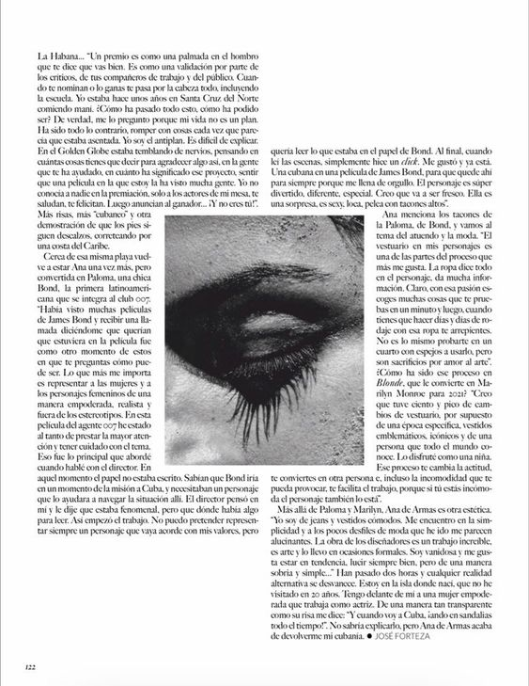
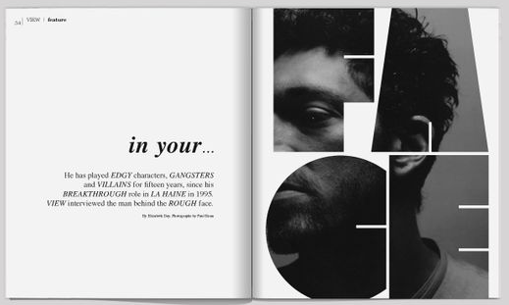
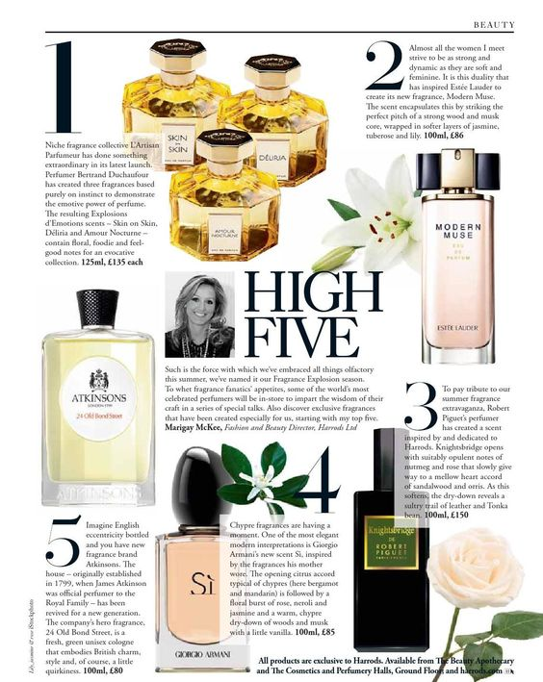
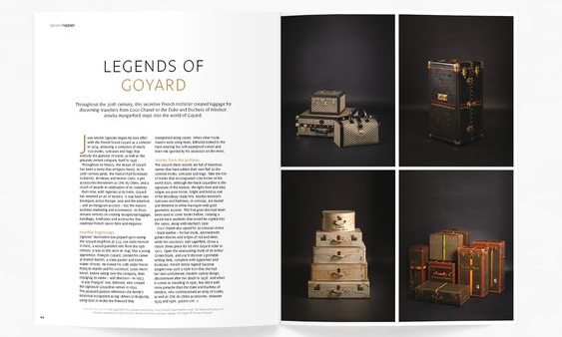
Moodboard:

Slide 26
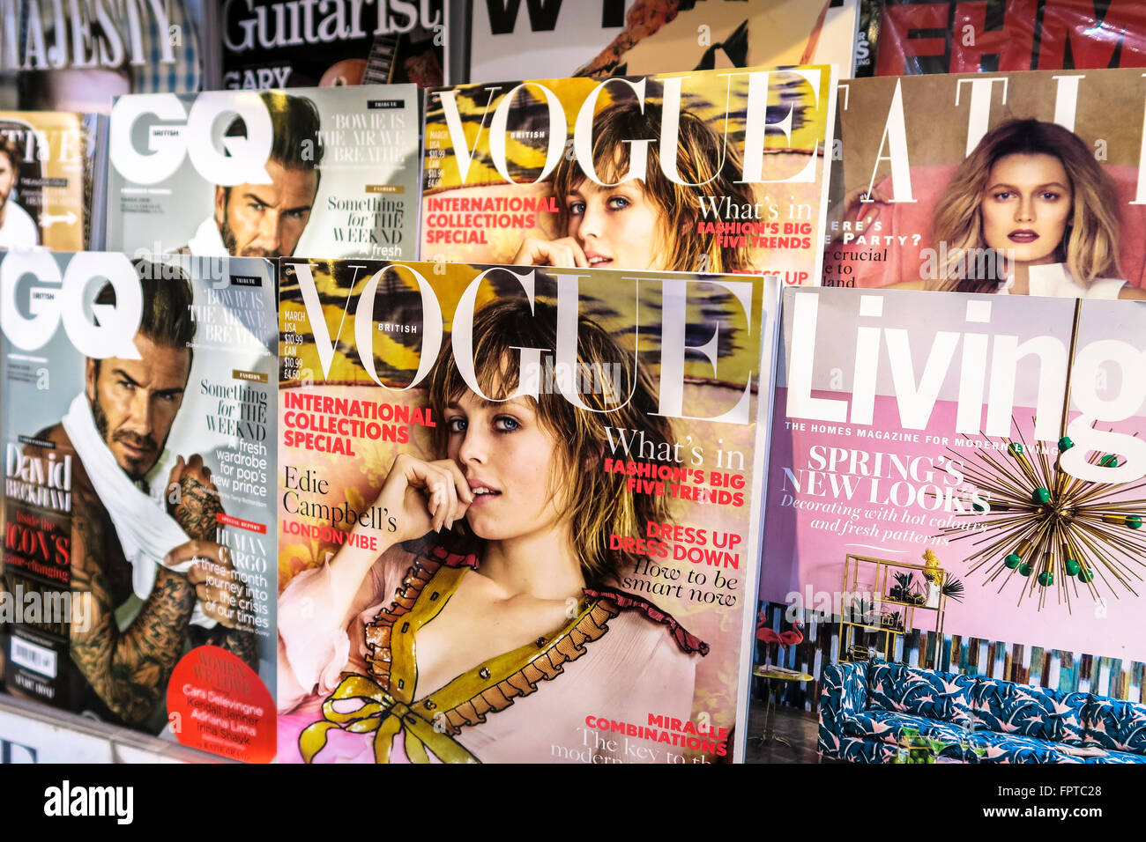
Project Screening:
Store shelf of the printed magazine -

Slide 27
Any Questions?
Thank you

