Slide 1

Spring 2023

Slide 2

Luxury Print Magazine

Slide 3


Slide 4


Slide 5
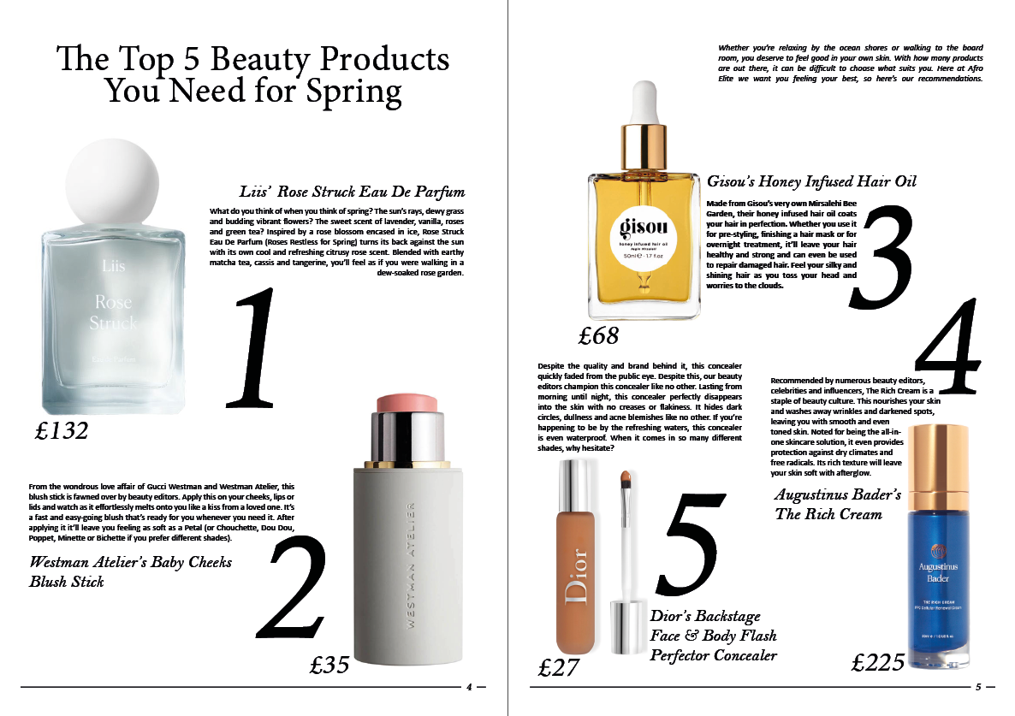

Slide 6
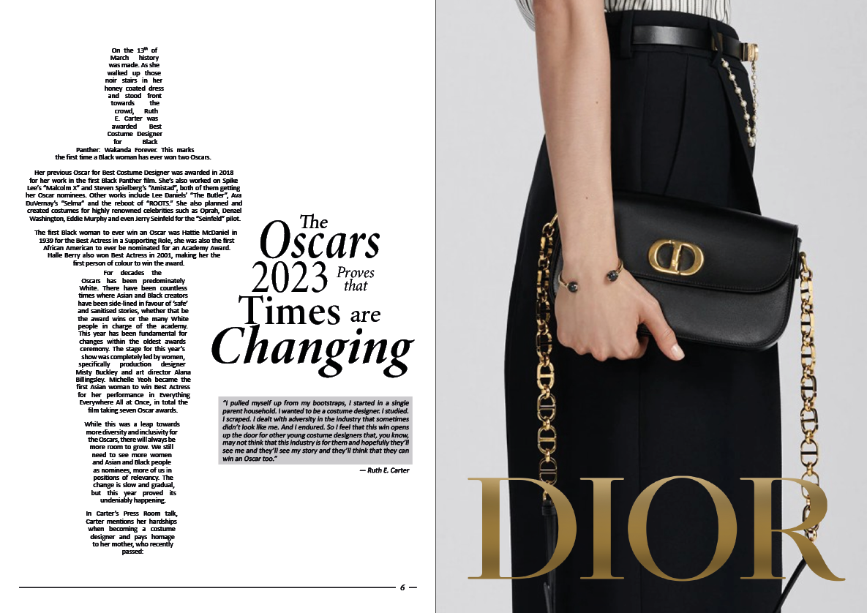

Slide 7
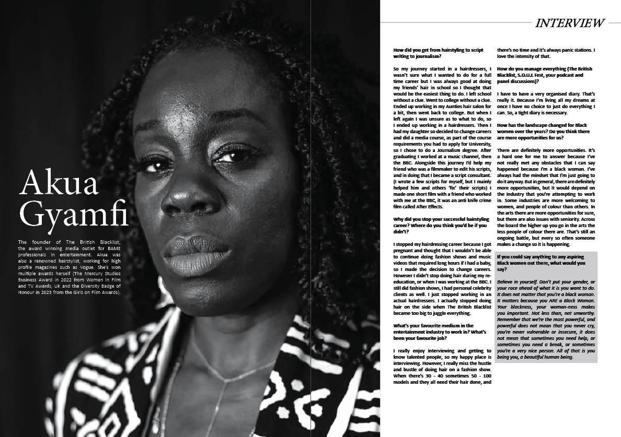

Slide 8


Slide 9


Slide 10
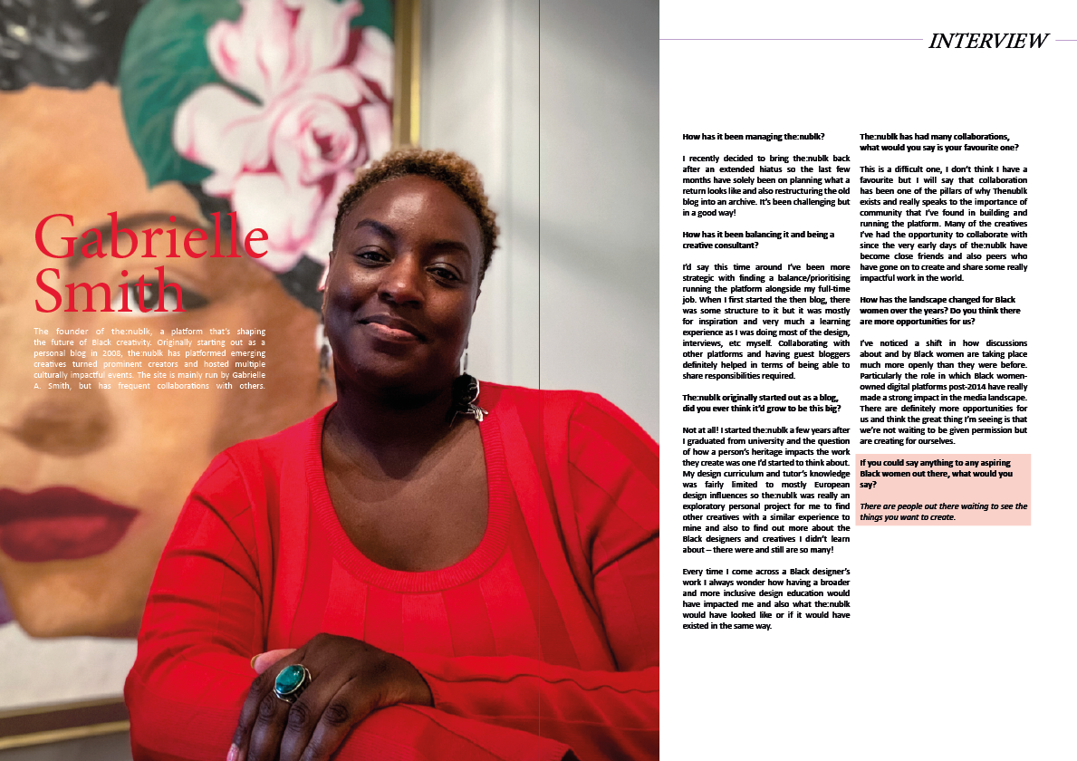

Slide 11


Slide 12


Slide 13


Slide 14
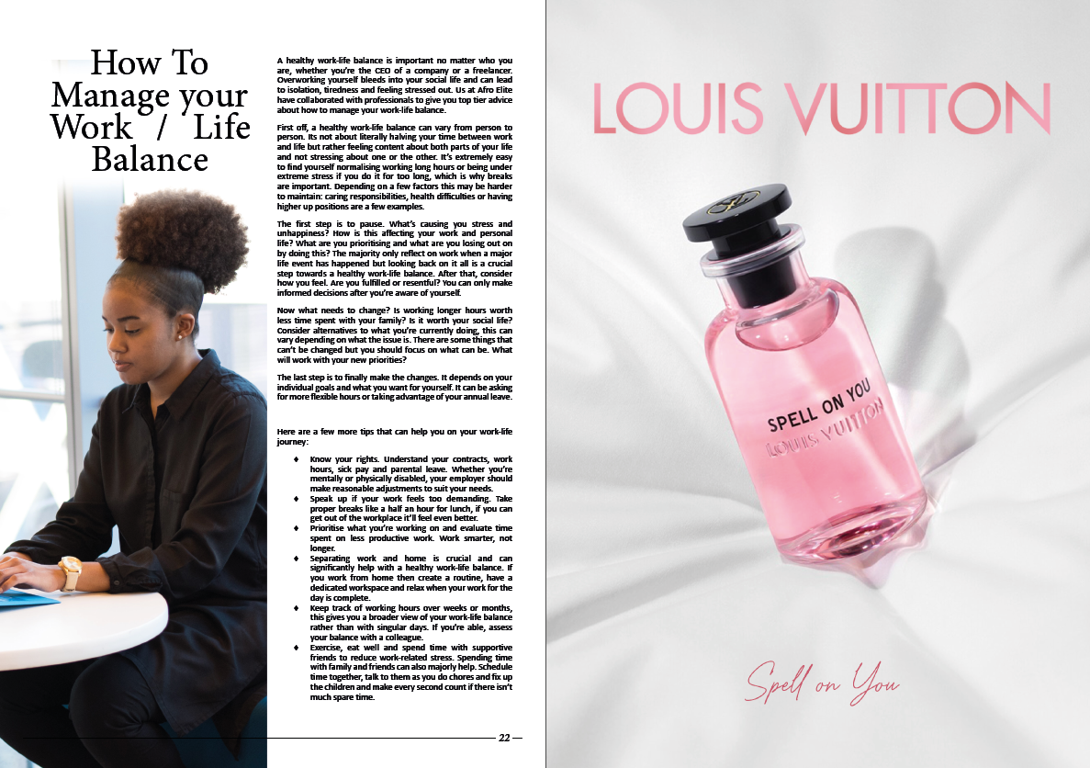

Slide 15

Thank you for Reading!

